Slide 1
We Shoot Stuff
Camera Shop

Slide 2
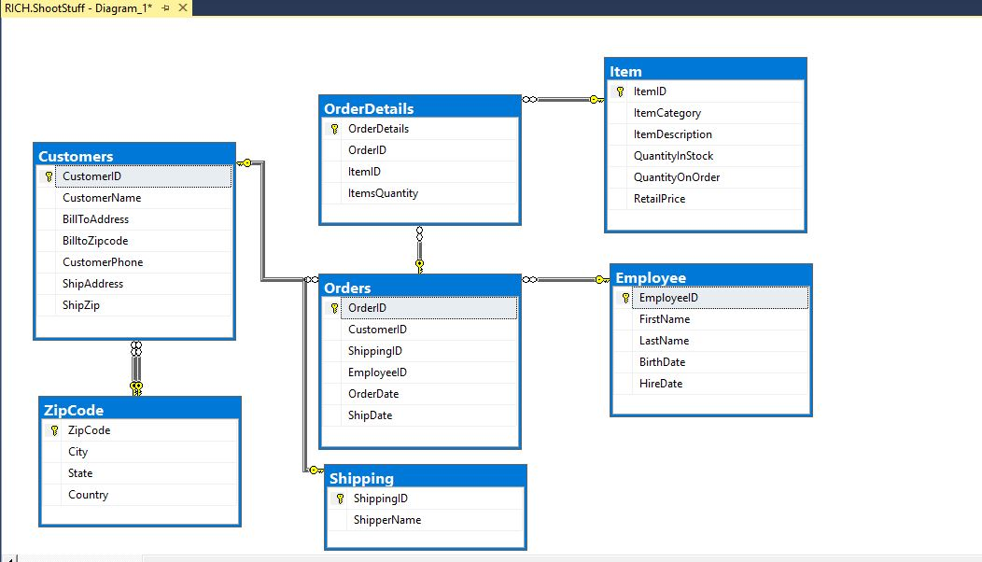
Database Diagram

Slide 3
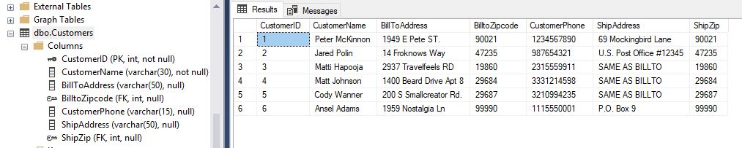
CUSTOMER

Slide 4
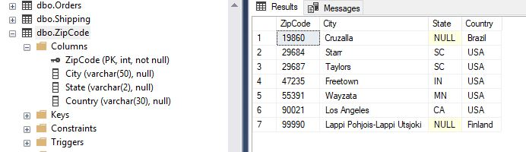
ZIPCODE

Slide 5
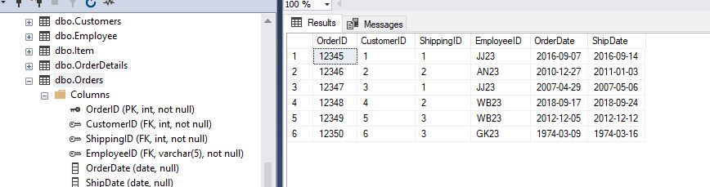
ORDERS

Slide 6

SHIPPING

Slide 7
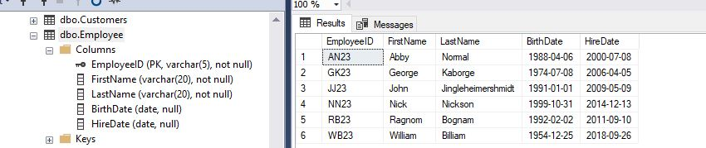
EMPLOYEE

Slide 8
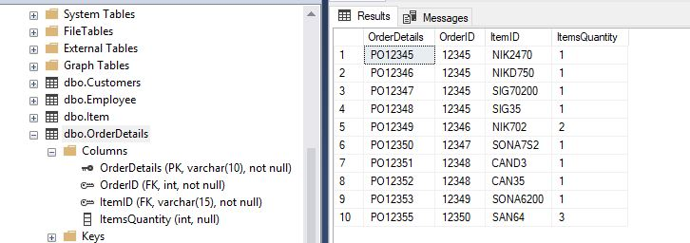
ORDER DETAILS

Slide 9
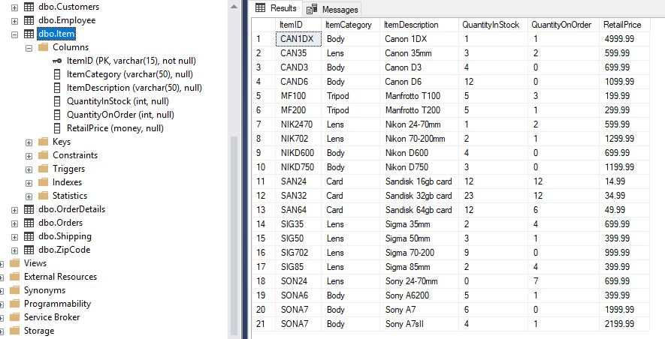
ITEM

Slide 10
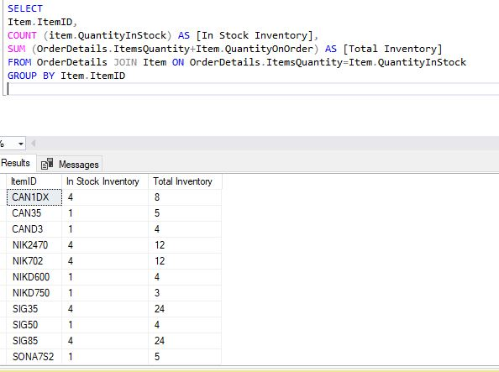
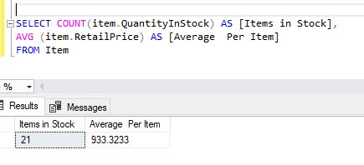
SUMMARY FUNCTIONS

Slide 11
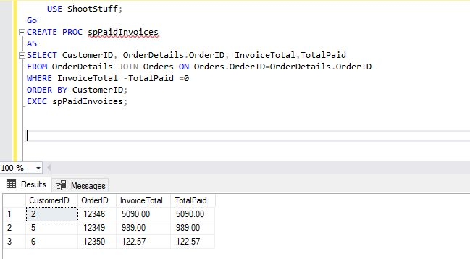
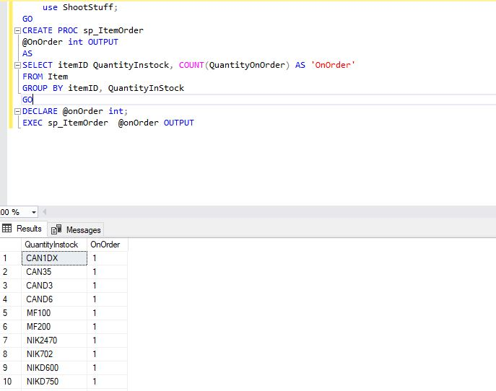
STORED PROCEDURES

Slide 12
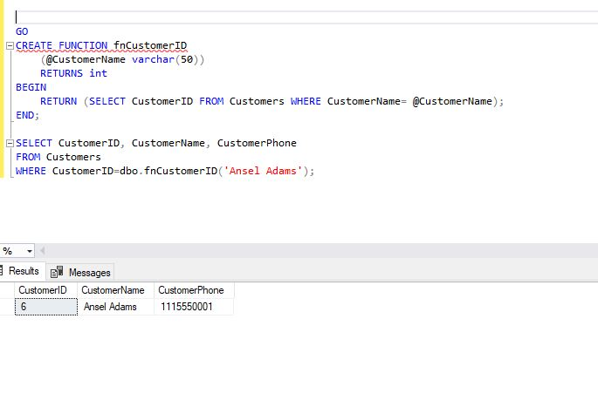
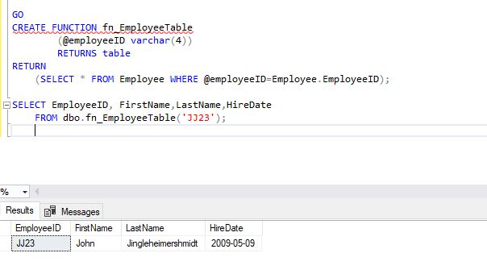
USER DEFINED FUNCTIONS

Slide 13
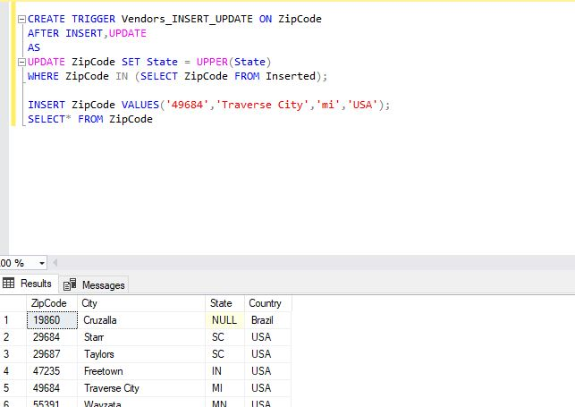
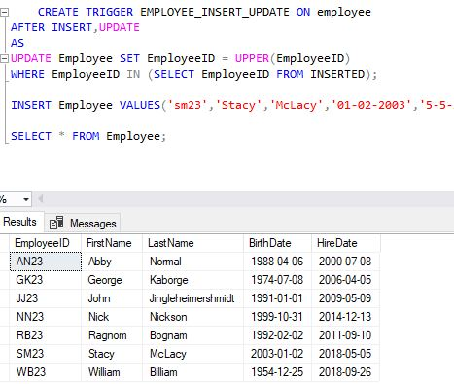
TRIGGER FUNCTIONS

Slide 14
Thanks For Listening!

